Slide 2
Understanding City Hall
Brownsville incorporated in 1876 which means the City became a recognized corporation under State Law which defines the Powers & Duties of a Municipal Corporation. (ORS 221.005 through 221.106)
Cities are required to follow the laws of the State which are found in the Oregon Revised Statutes (ORS). Some specific laws can be found in the Oregon Administrative Code (OAC). Federal Laws and Rules also apply.
Locally, the City operates generally under a charter. A charter is basically the City’s constitution; it grants specific powers and duties for appointed and elected officials.

Slide 3
Basic Types of Government Structures
Municipality
(Brownsville)
School District
(Central Linn Schools)
Special District
(Brownsville Rural Fire)
County
(Linn County)
State
Federal

Slide 4
CITIZENS
Mayor & Council
Planning Commission
Engineer
Administrator
Attorney
Court
Historic Review
Park Board
EPC
Budget Committee
Library Board
Judiciary
Planning
Librarian
Public Works
Billing
Finance
Court
Assistant
Operators
Volunteers
Brownsville Organizational Chart
Custodian

Slide 5
What Does the City Do?
Water Services
Wastewater Services
Planning & Zoning Services
Police Protection
Municipal Court
Parks & Recreation Opportunities
Library Services
Roads, Drainage & Street Lights
Cemetery Services

Slide 6
Personnel
Karl Frink – Superintendent
Josh Kometz – Operator
Andy Day – Operator
Water Supply & Distribution
* Plant, Chemicals & Testing Wastewater Treatment & Collections
* Hydrants, Valves & Piping * Plants, Chemicals & Testing
Roads * Plugs & Backups
* Maintenance & Upkeep Drainage
* Signage & Street Sweeping * Maintenance and Installation
Parks & Public Grounds Facilities
* Mowing & Tree Care * Improvements
* General Upkeep & Maintenance * General Upkeep & Maintenance

Slide 7
Public Works
The City must comply with the rules and regulations promulgated by the Federal Environmental Protection Agency (EPA) as adopted and enforced by the State of Oregon.
The City must comply with the rules and regulations promulgated and enforced by The Oregon Health Authority (OHA) for all water quality issues. The City must publish an annual Consumer Confidence Report (CCR). The City is also required to have an approved Water Master Plan on file.
The City must comply with the rules and regulations promulgated and enforced by The Department of Environmental Quality (DEQ) for all wastewater quality issues.
The City is required to have licensed individuals operating the Utility System; which the City has in Karl Frink. The City is also required to do extensive testing on the water and wastewater and provides weekly and monthly reports to both agencies.

Slide 8
Public Works
The City also deals with the Oregon Department of Transportation on all issues regarding OR 228. The City is not allowed by current laws to move as much as a tree without the expressed consent of ODOT. Any work performed by the City in the State’s right-of-way must be accompanied by a permit; even to access City owned utilities.
The Linn County Road Department has responsibility for several roads in town including Main Street, Washburn Street and Seven Mile Lane. The City must obtain a permit to work in these right-of-way areas as well.
The City requires Commercial Drivers Licenses (CDL) for certain kinds of equipment to be legally operated and must follow drug testing rules and guidelines as enforced by the Federal Highway Administration.
The City does apply pesticides and herbicides under the rules and requirements of the Department of Agriculture. Karl Frink is licensed and certified to perform these operations.

Slide 9
Fun Facts
The City produces nearly 90,000,000 gallons of water every year.
The City bills water consumption by the cubic foot. There are 7.48 gallons in one cubic foot.
One gallon of water weighs 8.34 pounds.
The City operates two reservoirs on the hill above Carlson’s Hardware. One is 1.1 M gallons and the other is .25 M gallons.
The water is treated at the Water Plant and pumped up the hill. The distribution system is gravity flow from there.

Slide 10
Fun Facts
The City is responsible for 49,090 linear feet of paved roadway; 9.29 miles… or 18.58 total miles…
The City is responsible for 60, 442 linear feet of water lines; 11.44 miles…
The City is responsible for 56,180 linear feet of sewer lines; 10.64 miles…
The City is responsible for 17,010 linear feet of storm sewer lines; 3.22 miles…

Slide 11
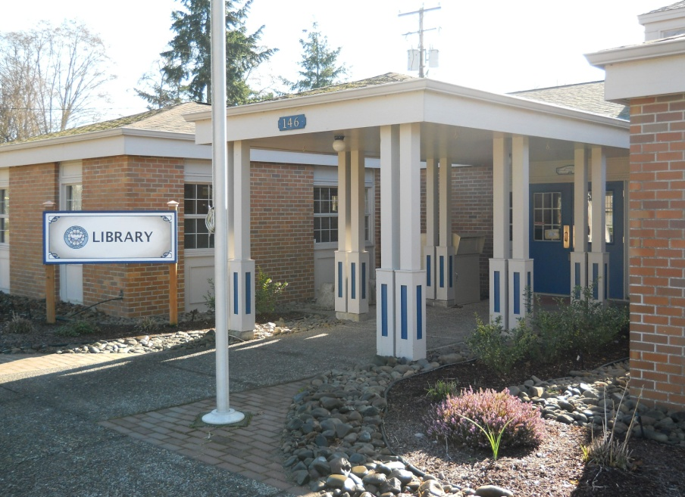
Library
Personnel
Sherri Lemhouse Librarian (Part-time)
Nettie Reed, Assistant (Saturdays)
Volunteers: 15 - 25
Groups
Library Advisory Board (ORS 357.400 through 357.621) was created by Council for the purpose of advising Council on Library Operations as defined in the Brownsville Municipal Code.
Women’s Study Club are responsible for originally creating the Library.
Friends of the Library donate resources to the Library.

Slide 12
Library
Fun Facts
Offers nearly 20,000 volumes.
Offers magazines, newspapers and periodicals.
Offers local historical documents.
Offers public computers.
Offers a large community room used for various purposes.
Annual circulation is approximately 13,000.

Slide 13
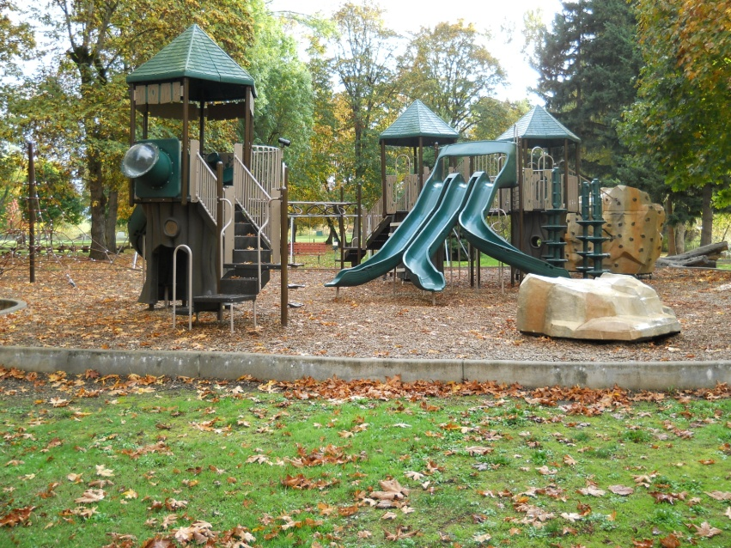
Parks
The City operates over 30 Acres of Parks including Pioneer Park, Kirk’s Ferry Park and Blakely Park.
Parks offer camping, basketball, playgrounds, ball fields, horseshoe pits, a covered dining pavilion with kitchen, summer swimming in the Calapooia and a covered stage.
Annual Events include the Pioneer Picnic, the Fourth of July Celebration and the Festival of Tents among others.
The City hires Park Care Takers who typically start the week before Memorial Day and work until the week after Labor Day.

Slide 14
Cemetery
The Cemetery is nearly 8 acres.
The City Offers plots for sale for $250 each.
The City is in the process of cleaning headstones and repairing broken ones.
The City is also in the process of healing relationships with the Cemetery Association.
The City would like to have an on-going volunteer program for upkeep and cleaning.

Slide 15
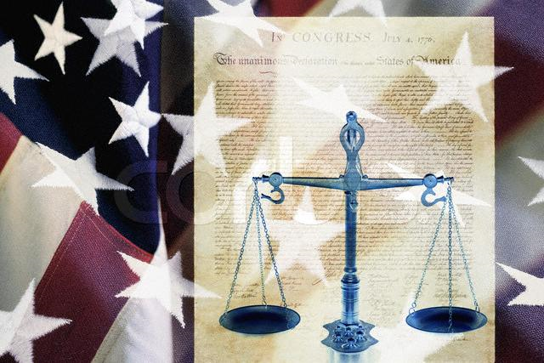
Police & Court
Personnel
Carol Humphreys, Court Administrator
Judge Jad Lemhouse (Contractual)
Robert Snyder, Prosecutor (Contractual)
Jim Yon, Sheriff
Michelle Duncan, Lieutenant
Greg Klein, Sergeant
Brandon Thurmond, Deputy
Scott Mumey, Deputy

Slide 16
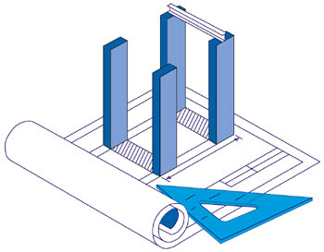
Planning
Personnel
Elizabeth Coleman, Administrative Assistant
Karl Frink,
Public Works Superintendent
Ryan Quigley, Dyer Partnership
Dave Kinney, Consultant
Governing Body
Planning Commission
The Planning Commission (ORS 227.010 through 227.170, 227.175 and 227.180) is required by State Law. The Commission is directly responsible for the enforcement of the Zoning Code & the Comprehensive Plan. The Commission handles variances, plats, subdivision and building plan reviews, easements, lot line adjustments and other property development issues.

Slide 17
Planning
The City has an Intergovernmental Agreement (IGA) with Linn County which allows the City to be a drop off point for building permits. The City does not enforce building permits; we simply make sure that the information provided is consistent with the Linn County Building Code and forward to the Linn County Building Department. All responsibility for the enforcement of the Building Code rests with Linn County per the IGA. People building in the City must go to Albany for Electric permits. The County has very comprehensive requirements including permits for hot water heaters and wood stoves.
Weed & Nuisance Abatement are conducted by the Planning Department to ensure compliance with the Brownsville Municipal Code.

Slide 18
Planning
All developments are required to submit plans per the Brownsville Municipal Code. Those plans are reviewed and approved by the City Engineer and the City Planner. The Public Works Superintendent is responsible for ensuring that the utility system integrity is maintained and TMDL requirements are met when improvements are made by any developer.
The State of Oregon keeps a close eye on all Land Use Planning requirements through the Department of Land Conservation & Development Department (DLCD). The Urban Growth Boundary (UGB), Annexation and “Build-able” Lands Inventory are all under the strict guidelines of the DLCD. Senate Bill 100 is still the standard in Oregon; it has done a very good job protecting farm & forest lands.

Slide 19
Fire Safety
The Brownsville Rural Fire District is considered a Special District with it’s own taxing powers and requirements under State Law. The District operates with one full-time Fire Chief and the rest of the Firefighters are volunteer. They have two locations in town; Main Street & Blakely Avenue. The City maintains a Class 4 ISO rating which is very good.
Kevin Rogers Fire Chief

Slide 20
Finances
Personnel
Tammi Morrow
Jannea Deaver
Boldt, Carlisle & Smith City Auditor
Governing Body
Council
Budget Committee
The Budget Committee is required by the Oregon Budget Law (ORS 294.305–294.565) and requires the seven members of Council and seven members of the community to work together to develop an annual budget for the City. Budget Committee members serve a three year term. Meeting are held in April and legislation is passed through May & June. All final budgets are due to the County by the second week of July.

Slide 21
Finances
The City uses the Oregon State Treasury. The City also maintains five primary accounts at Key Bank for the segregation of certain funds and actual transactions.
Main Account (OST - LGIP)
$4.9 M
The City has one Key Bank account:
1. General

Slide 22
Finances
The City budget comprises thirty-six pages of account breakdowns for both Revenues and Expenditures. The budget is a one year snapshot of activity projected by the Budget Officer for general government uses.
The budget breaks down generally in four major fund types: General, Special Revenue, Enterprise and Trust Funds. Cost Centers within these funds for General include Administration, Park & Cemetery, Fire, Law and Operations. Special Revenue includes Housing Rehabilitation, Water & Sewer Bond Funds, Bikeway, Transient Room Tax and Streets & Drainage. Enterprise Funds include Water & Sewer Administration and Operations. Trust Funds include Cemetery and Library.

Slide 23
Finances
The City follows rules and requirements enforced by the Department of Revenue and the widely recognized Governmental Accounting Standards Board (GASB) sets many financial policies and practices.
The day-to day business of the City runs through nearly every level of the organization. Jannea, Elizabeth and Tammi handle the billing and collecting for the Utility Accounts, Court Fines and Building Permits, respectively.
Bills owed by the City are physically paid by Jannea, signed and approved by Scott and one of the elected officials. Employees are required to pull a purchase order for any purchase. All purchase orders are approved by Scott; regular monthly bills are reviewed by Scott. Any irregular bills owed are generally handled by Scott and Tammi.
All purchases are made in accordance with organizational procedure and are in-line with the final budget document recommended by the Budget Committee and passed by Council.

Slide 24
Personnel
Position Descriptions were updated in November of 2007. All employees follow the policies and procedures as defined in the Employee Handbook which was also updated in 2007, 2010 and 2015. The Library Advisory Board Manual governs the Library as well as the Volunteer Manual.
Everyone working with the City is covered by Worker’s Compensation. Reporting is required annually and Council must pass a Resolution for verification purposes. The City Attorney and City/County Insurance Services provide valuable resources for keeping policies and procedures accurate with current laws. Training sessions are offered through the League of Cities and others for compliance issues. Council instituted a Performance Evaluation System in November of 2007 which requires every employee to be evaluated by their supervisor on an annual basis. The evaluation has also been updated.

Slide 25
Agreements & Contracts
The City maintains relationships through agreements and contracts with several non-profit groups to provide recreational opportunities for the citizens of Brownsville.
Examples include the Central Linn Recreation Center Board who operates leagues for youth of the community and surrounding areas. The Rec Board is responsible for programming and administration and the City provides the space and maintains the building. The Central Linn School District and the Calapooia Food Alliance are in an agreement for community garden sites behind the school on the south side of town. The Chamber of Commerce has an events agreement for Pioneer Park as does the Eugene Kennel Club. The Picnic Association is in an agreement for the Picture Gallery. The Brownsville Art Association for use of City Hall for their gallery space. The City works with the Chamber and the CLSD for the Festival Shuttle.

Slide 26
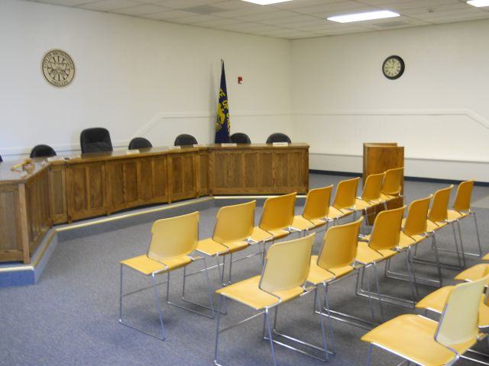
The Role of Councilor
Formulation of Public Policy
Policy is often, “what” and administration is typically viewed as “how” something will get done. Generally, Council forms the policy and staff is responsible for carrying out those goals.
Two Basic ‘Hats’ as a Councilor:
Convener – host, join, mediate with the public and each other regarding community issues.
Advocate – promote, advance, support a specific position or point of view.
You know versus People know: “The interesting thing about American politics is the people want someone in office who has all the answers but then wants them to listen to their ideas” ~ David Gergen

Slide 27
The Role of Councilor
One of the tricks to being effective is knowing when to switch hats between being an advocate for an issue and being a convener for the sake of the meeting.
Mayor – presides over meetings and is a regular voting member of Council according to the Charter.
Council President – runs Council meetings in the absence of the Mayor. The Mayor and Council President are responsible for Council conduct and personnel issues for the City.
Mayor Don Ware
"You can please all the people some of the time, and some of the people all the time, but you cannot please all the people all the time." ~ Abraham Lincoln (Variation)

Slide 28
The Role of Councilor
Council Rules (R 718)
Roberts Rules and meeting procedure.
General business conduct at a public meeting.
Public Meetings Law (ORS 192.610 to 192.710)
The law gives members of the public the right to attend all meetings of public bodies even if the board or committee is purely advisory. Convenient, public place, non-discriminatory, reasonable notice, written minutes are some of the basic requirements. Executive Sessions are private sessions which can be held to discuss certain private matters as described by law.

Slide 29
The Role of Councilor
Forms of Council Action
Ordinance – a general law of the City; a legislative action applicable to all citizens or to a certain groups within a community. Examples are establishing a sign code, allowing Social Gaming or levying the Transient Room Tax.
Resolution – a written legislative action that expresses the consensus of council concerning actions that are temporary, short-term or granting special privileges. Commonly used for adopting the budget, entering into contracts, tracking special expenditures and other administrative actions.
Motions – less formal than the other two forms. Generally used for common or ordinary tasks of Council such as approving minutes, delegating actions to staff or adjourning meetings.
The Mayor has the ability to pass a Proclamation. The purpose of a Proclamation is to state appreciation or express an interest in an accomplishment of a person, group or cause.

Slide 30
The Role of Councilor
Methods of Adoption
Ordinance – an ordinance adoption must have two readings. Council can make a motion to read the ordinance by title only but action cannot be taken on the adoption of the ordinance until the second meeting. Thirty days after the Council has passed the ordinance, it comes into effect. Council does have the power to adopt an “emergency” ordinance. That is done by a special motion which waives the thirty day waiting period.
Resolution – provides a written record of the action of Council; goes into effect immediately.
Motion – provides a witness of action in the minutes and records of Council.
Consensus – Council agrees to a decision by general confirmation. No official motion is made.

Slide 31
The Role of Councilor
Types of Meetings
Regular Council Session – is a set scheduled meeting of Council run under Robert’s Rules of Order with a specific agenda to be discussed and addressed; has inputs for reports and opportunity for Council to discuss items of business in open session.
Town Hall – a meeting held by Council to discuss a particular issue, idea or concept with members of the general public.
Quasi-Judicial Hearing – happen during regular meetings most often; appeals, zoning hearings and certain personnel issues require this function. Council acts strictly by procedures required for the type of hearing and must base their decision on the evidence as presented at the meeting.

Slide 32
The Role of Councilor
Ethics Law
The State Legislature is in the process of amending laws that were passed last legislative session. Historically, Councilors in small communities have only been required to file an annual Statement of Economic Interest (SEI) with the Oregon Government Ethic Commission (OGEC) which was very broad and trusting of elected officials. The current law requires extensive reporting of any gift valuing more than $50 of any person, group or entity with a legislative or administrative interest in the City, including relatives. Officials have to file quarterly reports and OGEC is required by law, until amended, to post certain personal information such as family members names on the Internet.
The Golden Rule – do not accept gifts within reason and declare any potential conflict of interest when discussing applicable topics. This requires not being involved in the discussion or the vote on the issue or topic.

Slide 33
The Role of Councilor
Intergovernmental Agreements (IGA) & Contracts
The City of Brownsville has entered into these agreements and contracts to provide services to the residents of the community. Examples of these agreements and contracts include the Oregon Economic & Community Development Department (OECDD), the United States Department of Agriculture (USDA), the Oregon Department of Transportation, Linn County Building Department, Rec Center Board, Pioneer Picnic Association (Picture Gallery), Central Linn School District, Calapooia Food Alliance (Gardens & Red Barn), Chamber of Commerce (Events), Judge Lemhouse’s Services, the City Administrator’s Services, Park Caretakers Services to name a few.
The City also enters into contracts to have vital services performed during the course of the year. Most of those contracts are job or work specific.

Slide 34
The Role of Councilor
Public Interaction
Public Meetings & Hearings
Advisory Committees
Neighborhood Associations
Public Opinions and Surveys
Volunteers
One on One
Media Relations – typically the City has uses the Mayor and Administrator when discussing issues with the media.

Slide 35
The End

