Slide 1
TMDL Overview

Slide 2
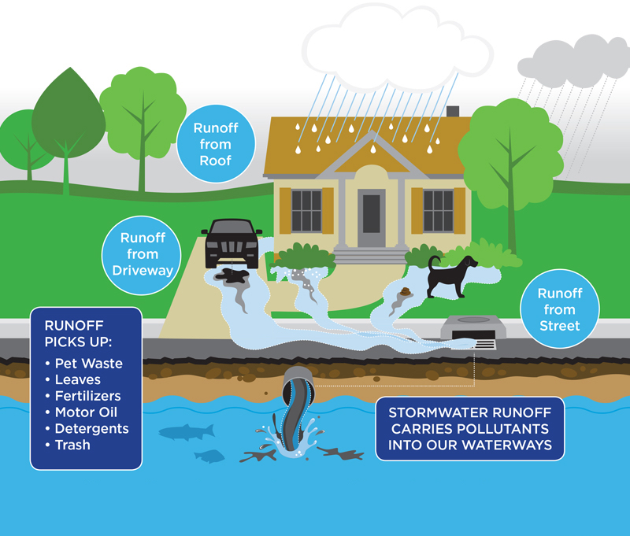
T
M
D
L

Slide 3
Forever Requirements
T
M
D
L
Temperature
Bacteria
Mercury
IDDE
All Pollutants
Riparian Vegetation, 2. Public Education, 3. WWTP – NPDES, 4. Tree City, and 5. Park Master Plan*
Pet & Animal Waste, 2. Stormwater BMP’s – Development, 3. I & I - Maintenance & Costs, 4. Erosion & Sediment Control, and 5. WWTP - NPDES
Erosion & Sediment Control, and 2. Stormwater BMP’s – Public Education
Public Reporting & Staff Tracking
Housekeeping: Street Sweeping; Leaf Collection, 2. Council Support, 3. Staff Reporting & Promoting, and 4) Watershed Support*

Slide 4
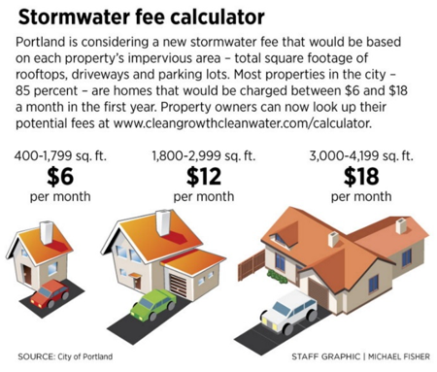
The General Concept

Slide 5
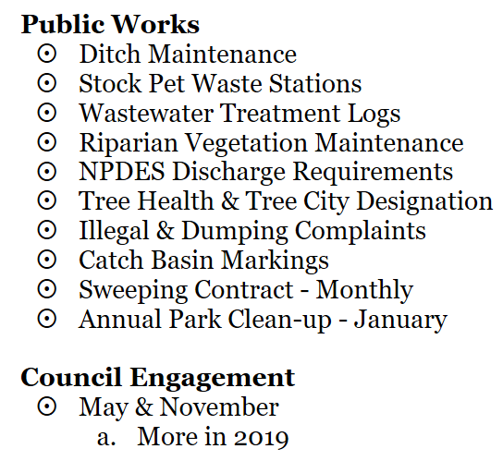
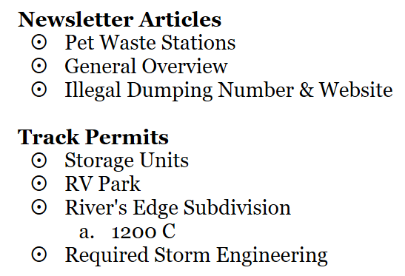
TMDL

Slide 6
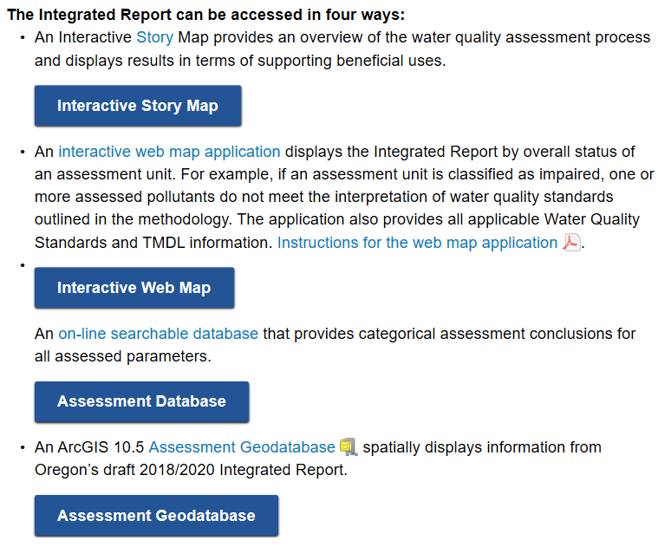
Integrated Reporting
https://www.oregon.gov/deq/wq/Pages/2018-Integrated-Report.aspx

Slide 7
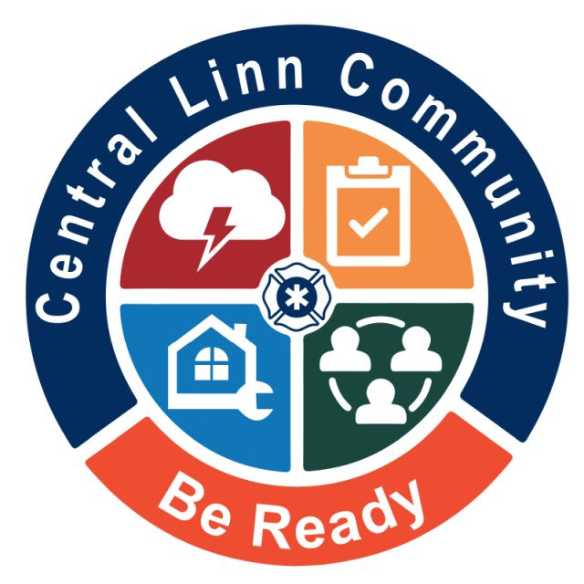
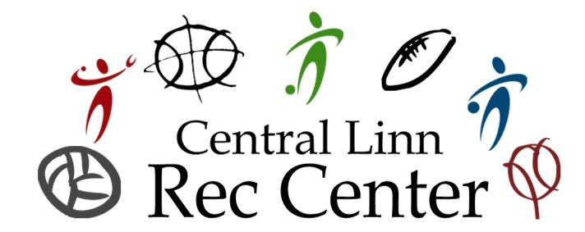
Ad Hoc Committee

Slide 8
LOC Advocacy

Slide 9
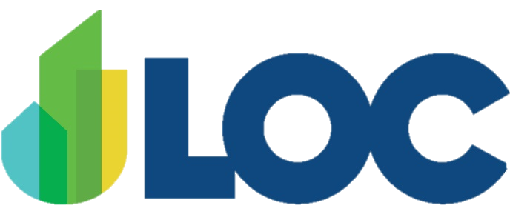
LOC’s Advocacy Program
What we do:
Interim: Setting LOC’s legislative agenda
Policy Committee Process
Rulemaking and state agency outreach/coordination
Stakeholder engagement/communication
Legislative engagement during session
Tracking ~ 1200 bills + for cities
Pro-active legislation vs. playing defensive role
Leveraging relationships/coalitions (knowing who the players are
Knowing the process (timing, legislative rules, amendment tracking, testimony, legislator meetings, etc.)
What we don’t do:
Campaign contributions
Ballot measures
“If you’re not at the table, you are likely to be on the menu!’

Slide 10
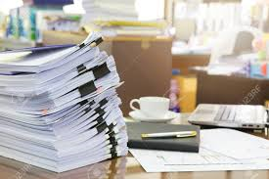
Quick Facts – Oregon Legislative Process
Odd-numbered year (“long session”)
Not to exceed 160 days
Unlimited number of bills
Typical long session = ~3,000 bills
Biennial budgets set through this process
Even-numbered year (“short-session”)
Not to exceed 35 days
Limited number of bills
Unresolved budget issues addressed during short session (e.g. emergency funding requests, or items still needed but not funded during previous long session)
Legislative Turn Over – 30 senate/60 house – recent years 20% turnover (16 in house last session)

Slide 11
Tips for Effective Legislative Advocacy
Establish relationships with legislators in advance!
Tours; coffees; etc.
Ask if there are ways you can help them achieve their legislative goals – this relationship should be a two-way street.
Know your senator’s and representative’s committee assignments.
Target interim outreach to their policy committee work.
Don’t forget about the importance of legislative staff!

Slide 12
Additional Tips…
Know your LOC lobbyists and what issue areas they cover (portfolio assignments document)
Be familiar with the Oregon Legislative Information System (OLIS)
Attend City Lobby Day in Salem (long session only)
Read the LOC Bulletin!
Know about other communication methods for LOC:
Podcasts
Social media (#orpol; #orleg; #orcitiesleg)
Legislative alerts
Understand fiscal impact statements
Be ready to provide effective written/oral testimony

Slide 13
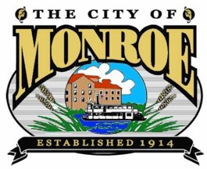
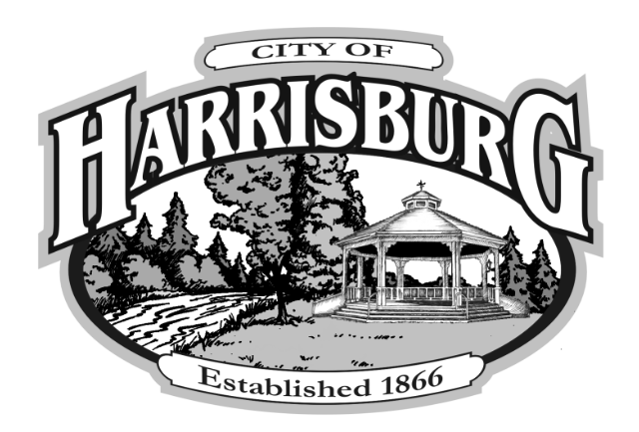
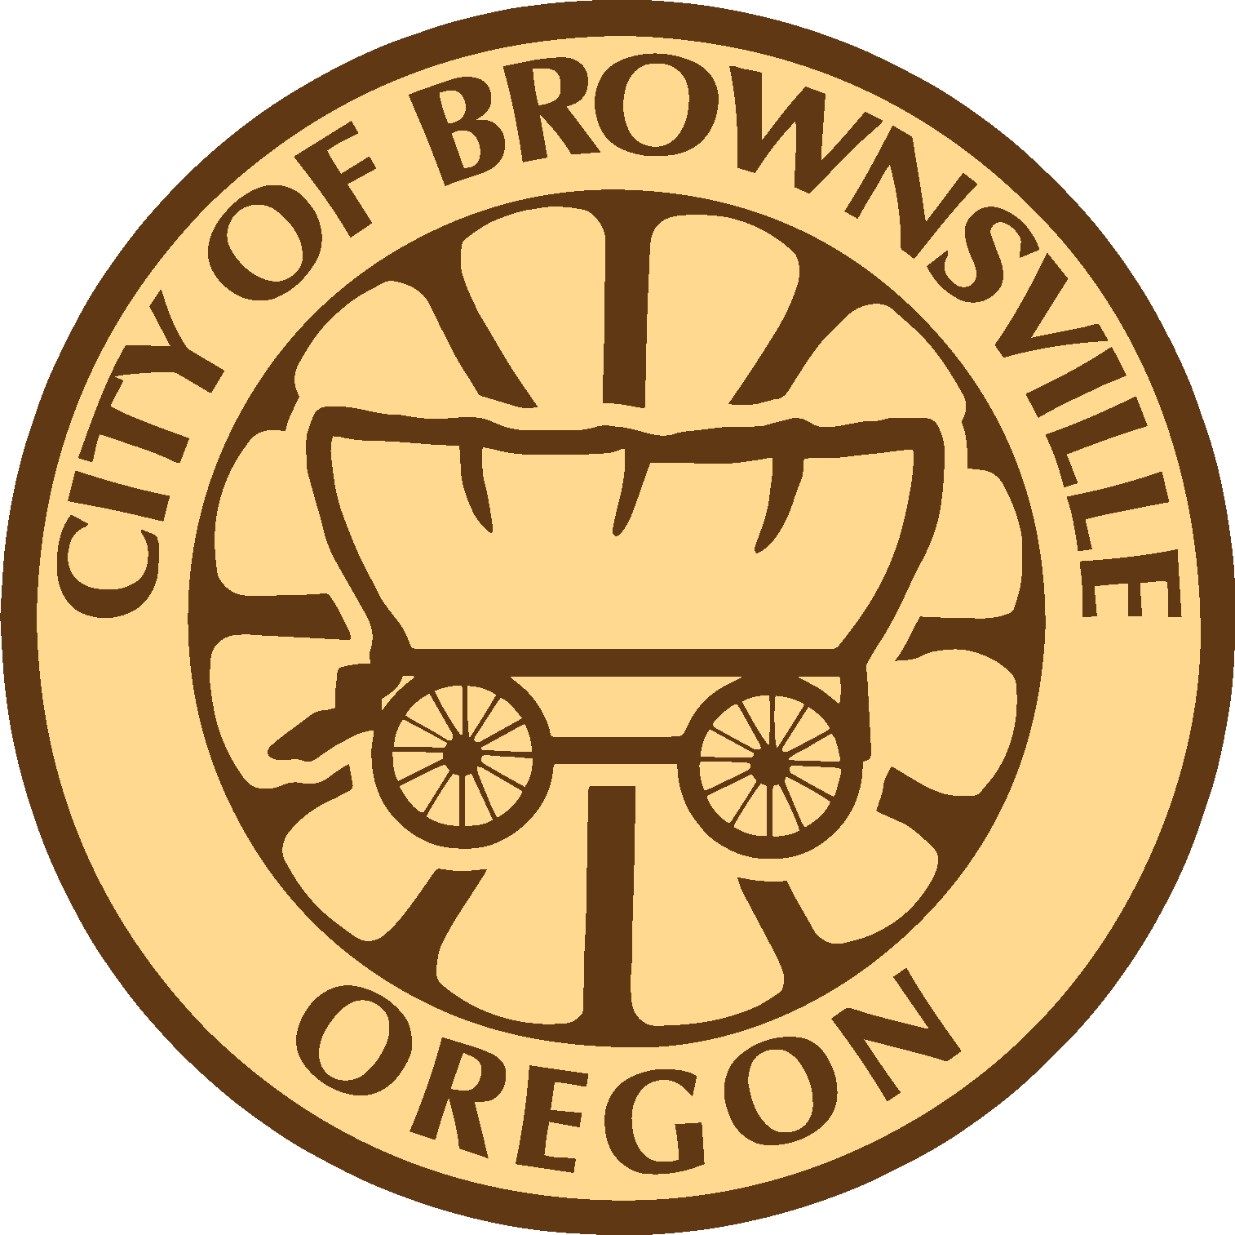
Step #3: COG’s work closely with the LOC to broadcast policy objectives and concerns outside and during legislative sessions.
[Six counties included: Marion, Polk Yamhill, Linn, Benton & Lincoln nearly 60 entities]
Step #2: Cities coalesce policy objectives for legislative session in-line with LOC objectives and objectives germane to our area. COG’s host annual gathering with local leaders and legislators.
Step #1: Cities from both Councils of Governments develop their individual policy directives and build relationships with State legislative officials.

Slide 14
Alyrica Lease

Slide 15
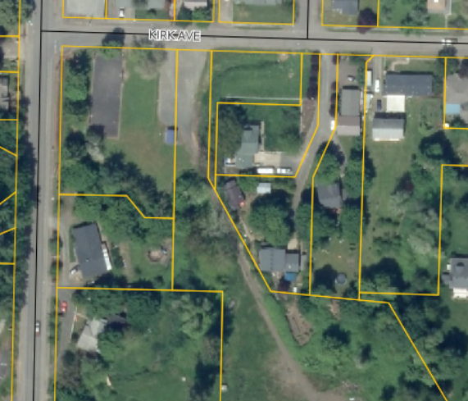
Proposed Lease
City Owned Property
Proposed Location

Slide 16
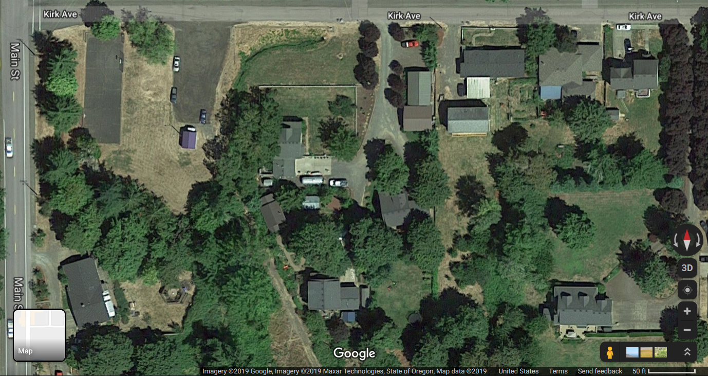

Slide 17
Sheriff’s Office Contract

Slide 18
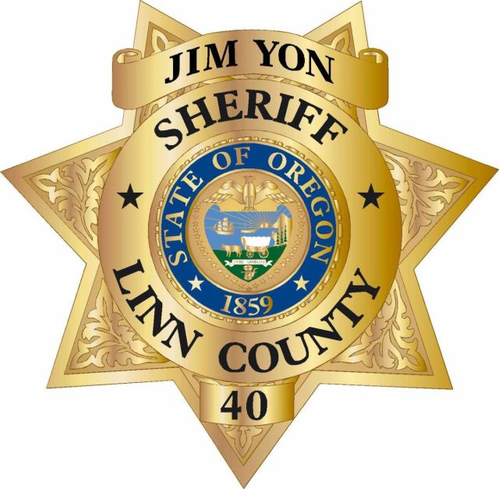
Agreement Points
Harrisburg Pilot Program
Matrix & Results
Duncan & Klein
Traffic Monitoring Equipment

Slide 19
Canal Company

Slide 20
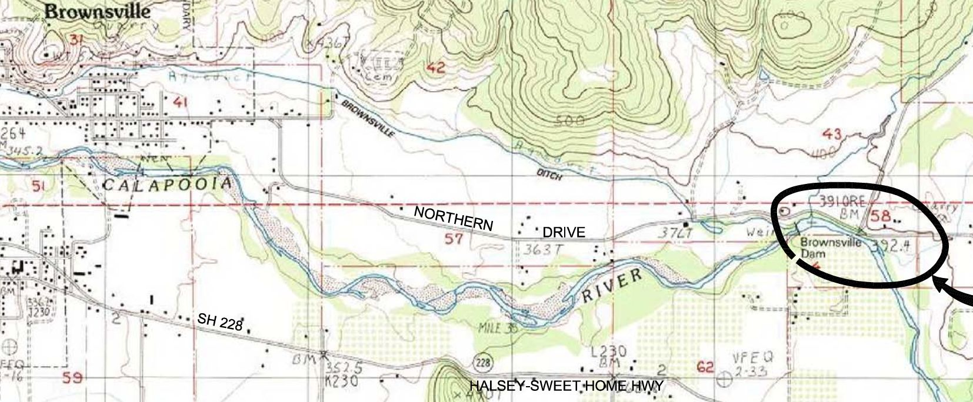
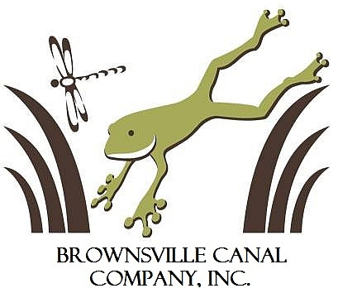
Brownsville Canal Company, Inc.
N
Vicinity Map

Slide 21
Brownsville Canal Company, Inc.
Filed Articles of Incorporation – April 15th, 1965
Purpose:
Water and canal privileges include flood control, irrigation, and livestock.
Purchase real estate.
Borrow money and other indebtedness instruments and enter into agreements & contracts.
Canal services and water shall be provided at associated costs on a non-profit basis.
The Canal Company has revised their bylaws in 1975, 1988 & 1991,
but no revisions changed the purpose of the Company.

Slide 22
The City & the Company
Options:
Do nothing.
Propose an ORS Drainage Taxing District.
Create a partnership agreement with the Company. The City would act as fiduciary agent, continue operations, and begin re-establishing the canal through third-party contractual arrangements made by the Company as funding allows.
Create a partnership agreement with the Company. Create a city-wide stormwater utility encompassing all property owners of Brownsville. Establish a division that pertains to the agreement with the Company.
Other Variations.

Slide 23
The City & the Company
Benefits:
City taxpayers are not footing the entire bill for the Company.
The people benefitting are the people paying for the service.
Maintenance is easier to contract.
Operational funds pay for insurance & future maintenance.
Standards are established for culverts & crossings.
A long-standing source of contention is resolved.
Water is drained properly and more efficiently.
Clear lines of responsibilities are established.

Slide 25
Right-of-Ways

Slide 26
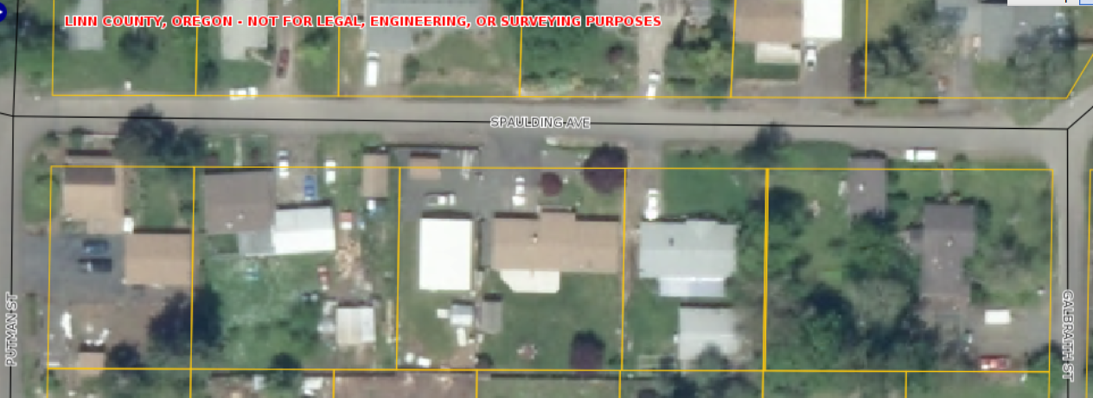

Slide 27
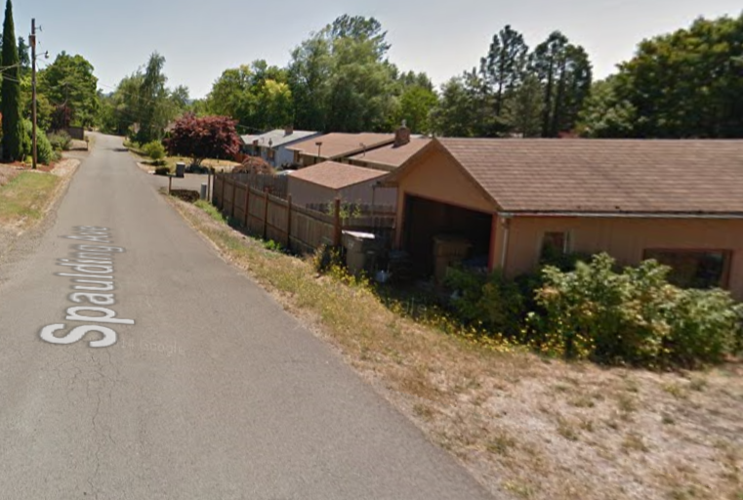
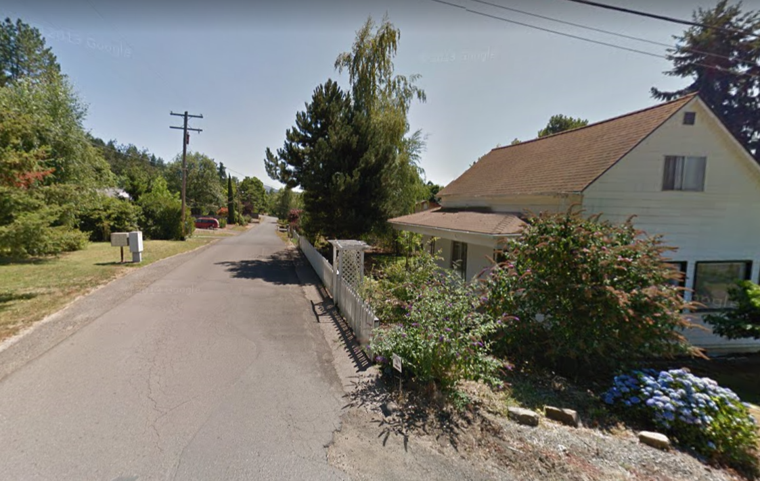

Slide 28
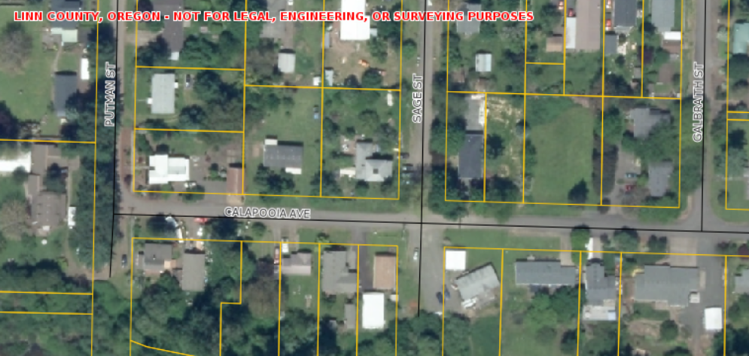

Slide 29
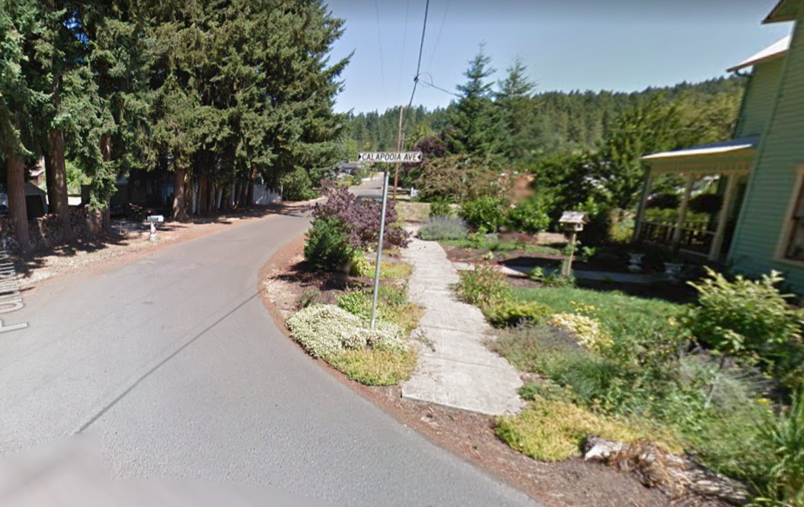

Slide 30
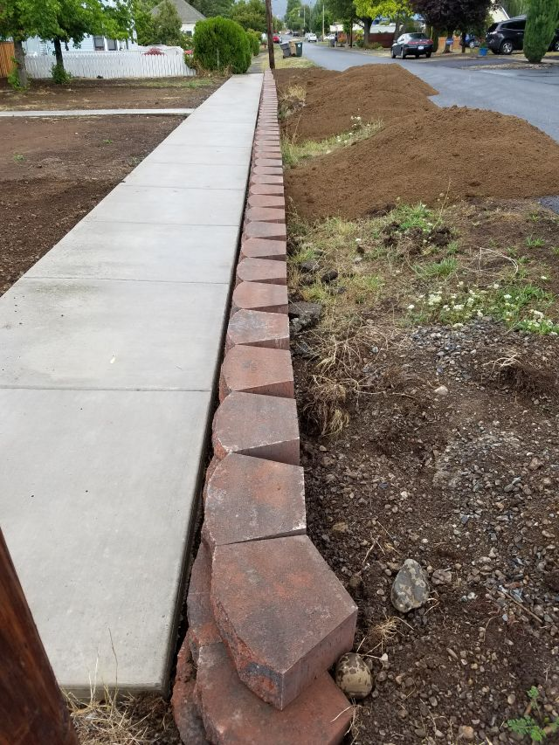
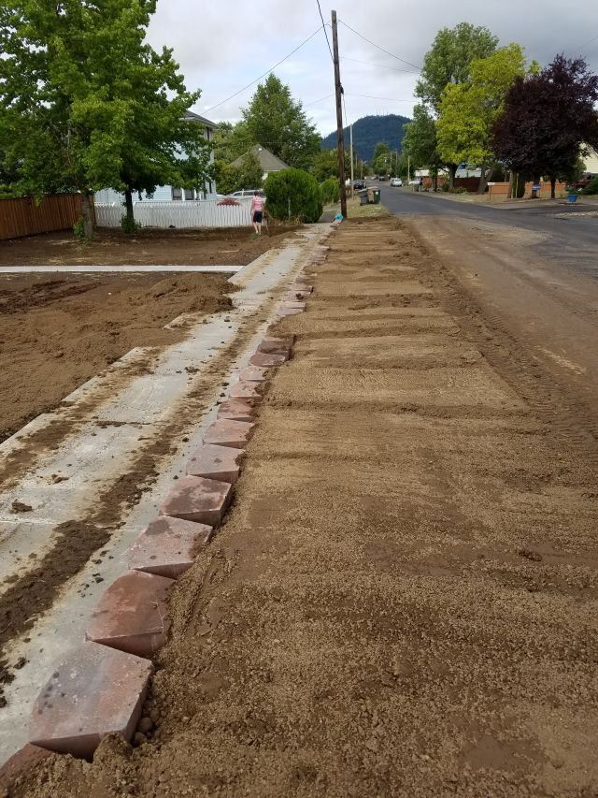

Slide 31
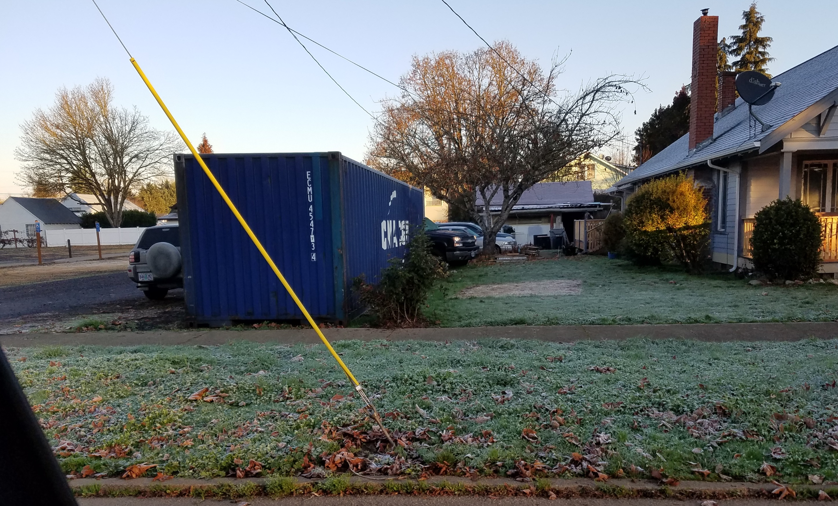
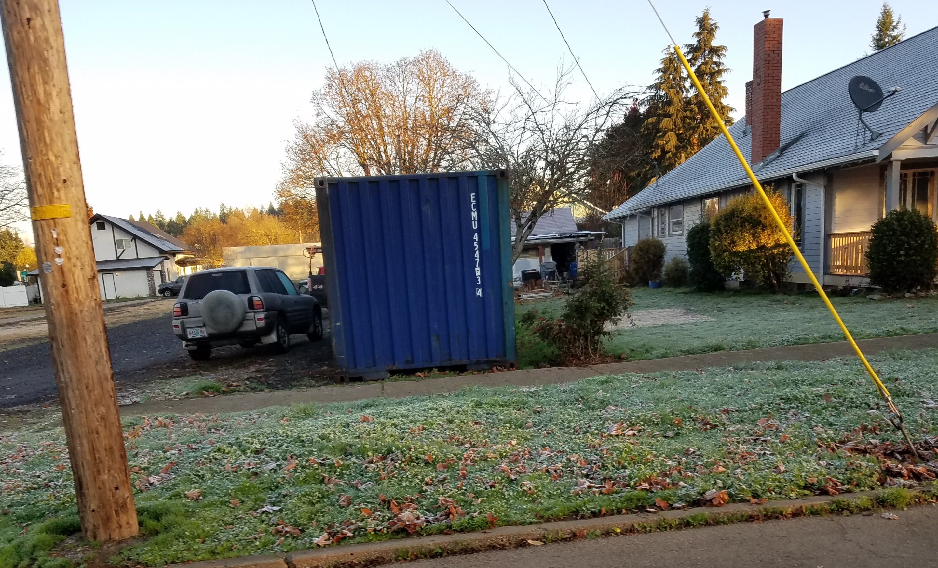

Slide 32
The End

Slide 33
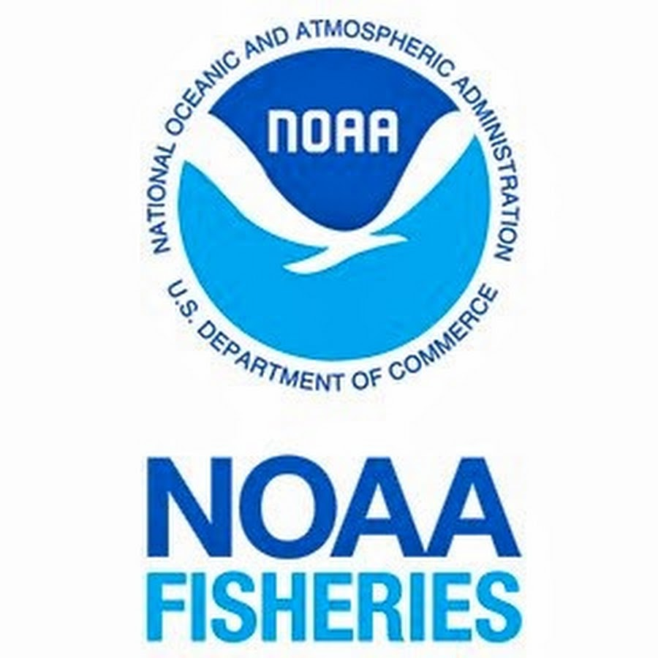

Slide 34
