Slide 1

Brownsville Canal Company, Inc.
Past & Present

Slide 2
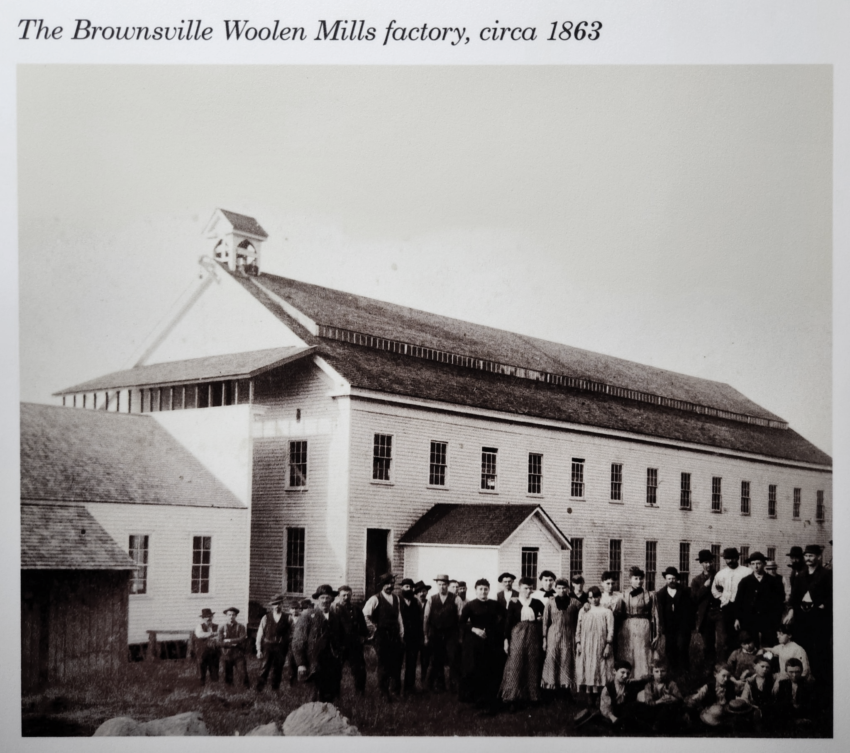

Slide 3
Brownsville Canal Company, Inc.
Filed Articles of Incorporation – April 15th, 1965
Purpose:
  Water and canal privileges include flood control, irrigation, and livestock.
  Purchase real estate.
  Borrow money and other indebtedness instruments and enter into agreements & contracts.
  Canal services and water shall be provided at associated costs on a non-profit basis.
The Canal Company has revised their bylaws in 1975, 1988 & 1991,
but no revisions changed the purpose of the Company.

Slide 4
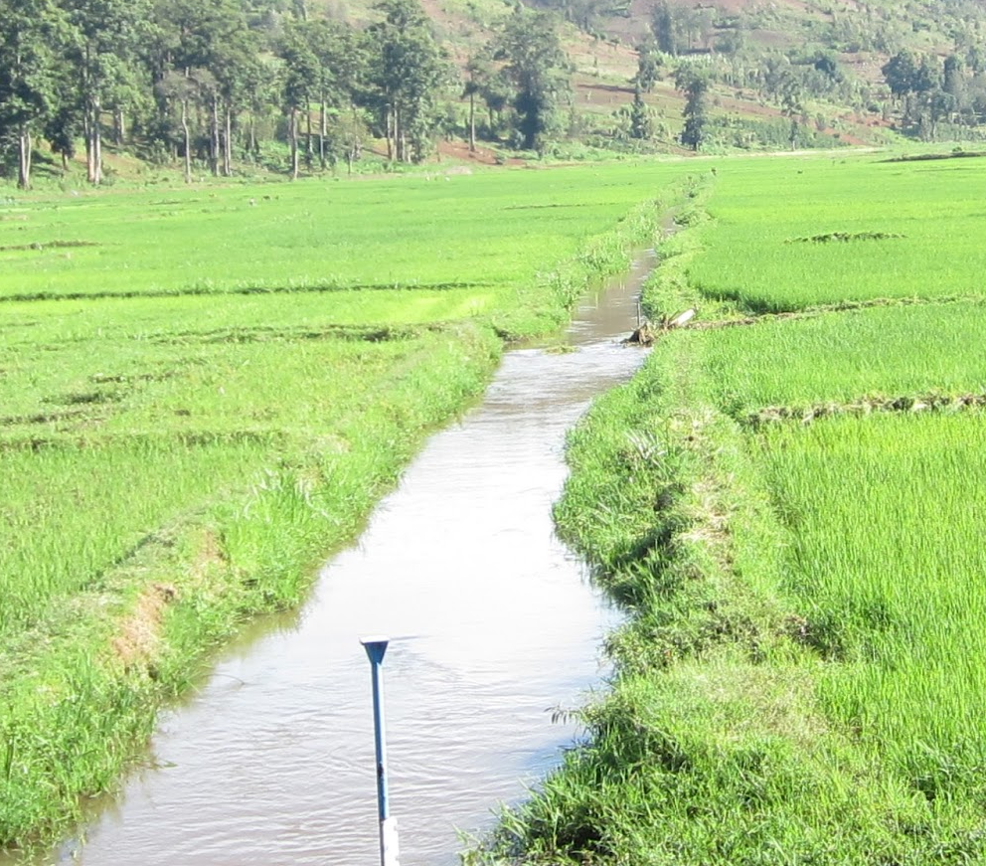
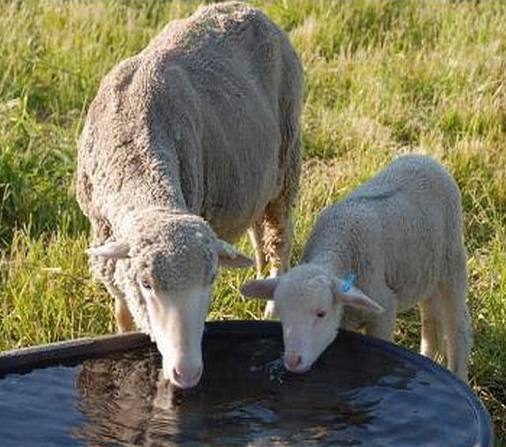

Brownsville Canal Company, Inc.
Vector Control
Flood Control & Irrigation
Livestock Watering

Slide 5


Brownsville Canal Company, Inc.
Practice:
  Members assisted each other controlling irrigation and water use for livestock.
  Members used to dam the Calapooia River annually.
  Members share duties and, in some cases, money was
  collected to make improvements and repairs.

Slide 6

Brownsville Canal Company, Inc.
Recent History (2004-2008):
  Members disagreed over the removal of the dam proposed by the Calapooia Watershed Council.
  The Calapooia Watershed Council forged ahead with multiple State & Federal agencies to remove the dam and install pumps to force water into the canal.
  The City of Brownsville secured an easement from John Holbrook and passed two Resolutions, 605 & 611, regarding the disposition of the canal; entered into agreement with Pacific Power.
  Members grew concerned about personal liability by being a member or owning land adjacent to the canal.
  Membership no longer cooperates with each other which has led to divisions that are unresolved to date.

Slide 7

Brownsville Canal Company, Inc.
Recent History (2008-Present):
  The City of Brownsville has had Staff keep the canal operational over the last seventeen years at the City’s expense.
  Officers worked with a several attorneys to redefine membership.
  Officers purchased liability insurance for membership and did their best to answer liability questions & concerns.
  Officers made repairs to the canal at their own expense both monetarily and in sweat equity.

Slide 8
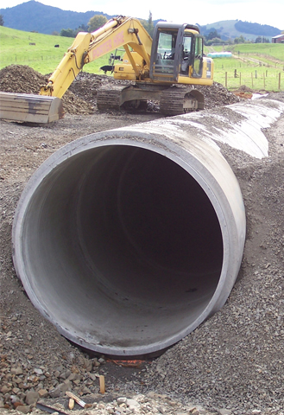
Brownsville Canal Company, Inc.
Recent History (2008-Present):
  Officers determined the Company owns a forty-foot (40’) strip of land from the Calapooia River to the Eagle Woolen Mill site on Millhouse Street.
  The canal has rarely been cleaned or re-established for years.
  Officers have considered standards for culverts and crossings of the canal, but nothing has been implemented.
  Officers & members temporarily entertained dissolution of the Company.

Slide 9
Brownsville Canal Company, Inc.
Future

Slide 10

The City & the Company
Options:
  Do nothing.
  Propose an ORS Drainage Taxing District.
  Create a partnership agreement with the Company. The City would act as fiduciary agent, continue operations, and begin re-establishing the canal through third-party contractual arrangements made by the Company as funding allows.
  Create a partnership agreement with the Company. Create a city-wide stormwater utility encompassing all property owners of Brownsville. Establish a division that pertains to the agreement with the Company.
  Other Variations.

Slide 11


The City & the Company
Obstacles & Challenges:
  Lack of General Public Knowledge & Purpose.
  Lack of Cooperation.
  Strong Personalities.
  Personal Histories.
  Historical Differences.
  Financial Concerns.
  Ownership Disputes.
  Lack of Leadership.
  Political Will.
  TMDL & State Agencies.

Slide 12

The City & the Company
Benefits:
  City taxpayers are not footing the entire bill for the Company.
  The people benefitting are the people paying for the service.
  Maintenance is easier to contract.
  Operational funds pay for insurance & future maintenance.
  Standards are established for culverts & crossings.
  A long-standing source of contention is resolved.
  Water will be drained properly and more efficiently.
  Clear lines of responsibilities are established.

Slide 13
Brownsville Canal Company, Inc.
Proposed Numbers

Slide 14
Brownsville Canal Company, Inc.
Benefitting Brownsville Properties
# of Properties | $ per Year | Subtotal
230 $50 $11,500
230 $60 $13,800
230 $70 $16,100
230 $80 $18,400

Slide 15
Brownsville Canal Company, Inc.
Water Right Properties
# of Water Rights | $ per Year | Subtotal
13 $200 $2,600
13 $250 $3,250
13 $300 $3,900
13 $350 $4,550

Slide 16
Brownsville Canal Company, Inc.
Annual Revenue Yield Range
Total
City 230 Rights
$50 $14,100 $200
$60 $17,050 $250
$70 $20,000 $300
$80 $22,950 $350

Slide 17

Brownsville Canal Company, Inc.
The Canal Company determines how the money will be distributed between the three funding categories, Annual Operating Expenses, Immediate Repairs, and Future Improvements.

Slide 18



Brownsville Canal Company, Inc.
Annual Operating Expenses: Insurance - $850/year
Electricity - $2,500/year.
Future Improvements: Savings toward major improvements like surveying the ditch, preparing for a major cleaning. Saving for future pump replacement costs.
Immediate Repairs: Leaks, breaches, problem trees, keeping the ditch free & clear.

Slide 19
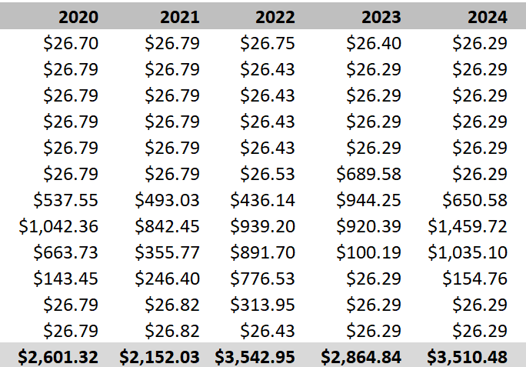

Brownsville Canal Company, Inc.

Slide 20
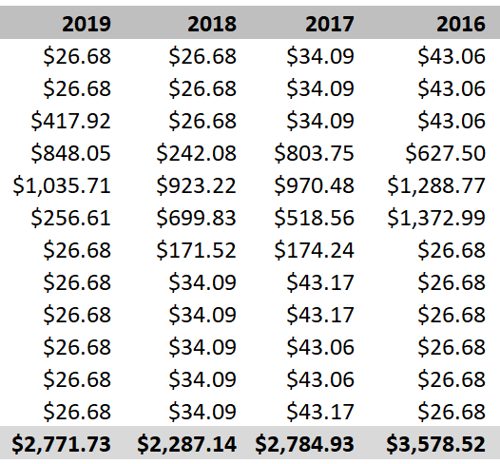
Brownsville Canal Company, Inc.

Slide 21
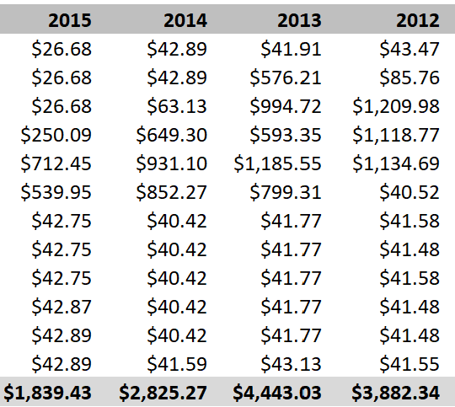
Brownsville Canal Company, Inc.

Slide 22
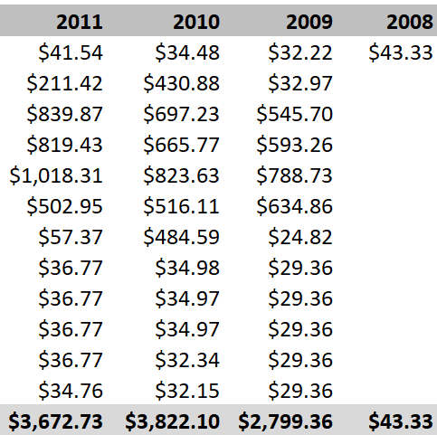
Brownsville Canal Company, Inc.

Slide 23

City Concerns

Slide 24

Brownsville Canal Company, Inc.
Why is the City getting involved?
Over 200 residents benefit from the proper maintenance of this drainage canal. All Brownsville taxpayers have been paying for the costs since 2008. The City has an aesthetic water right.

Slide 25

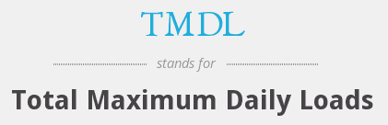

New Requirements
No longer voluntary
Required:
ORS
OAC
Federal Code

Slide 26

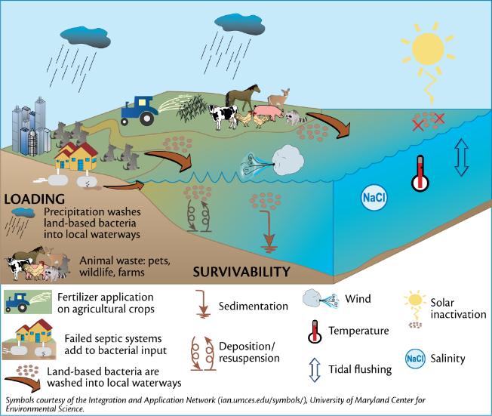

Slide 27
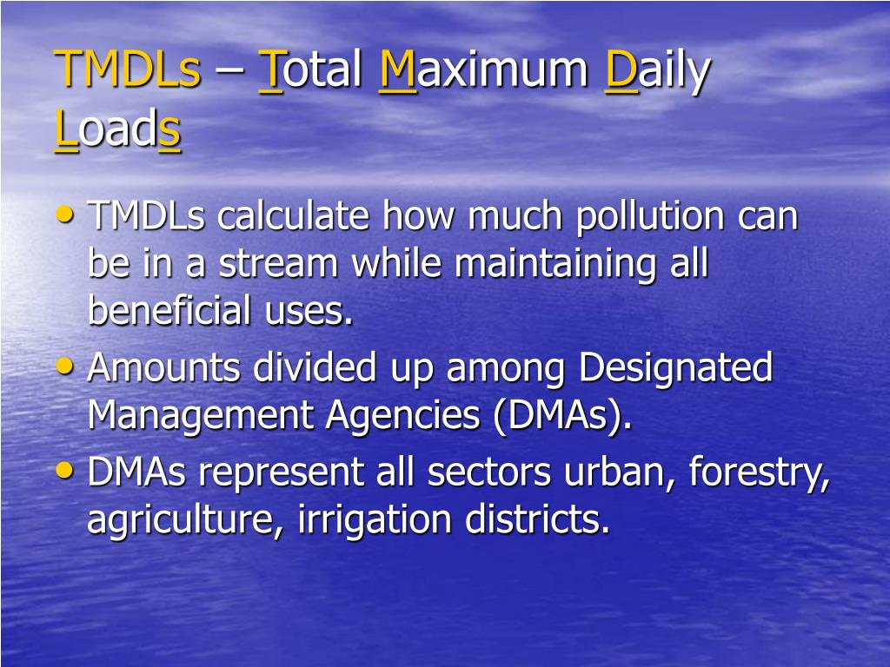


Non-profit Groups +

Slide 28

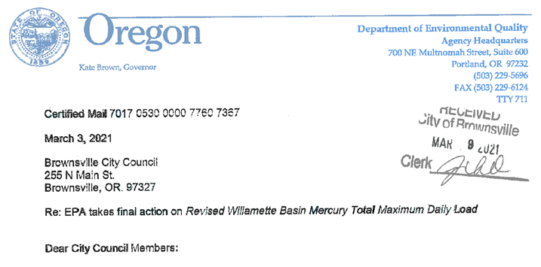

Designated Management Agency (DMA)
Final U.S. EPA Ruling

Slide 29
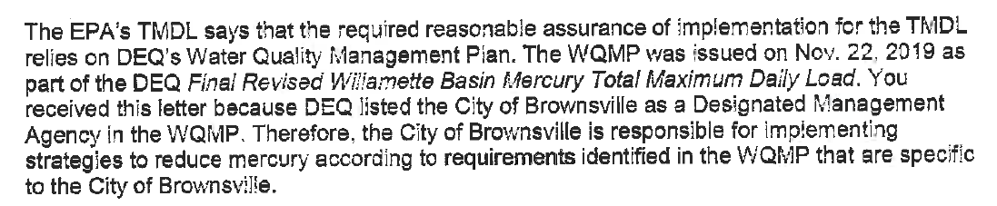
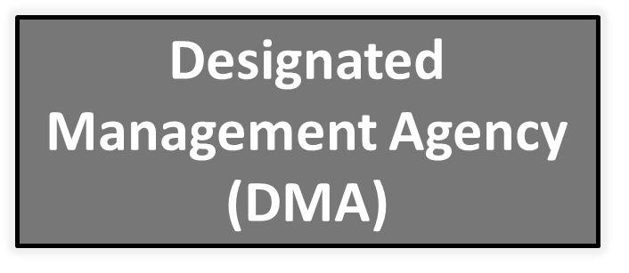
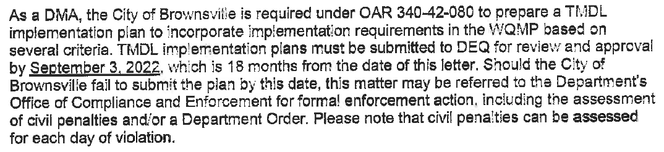
Designated Management Agency (DMA)
Final U.S. EPA Ruling

Slide 30
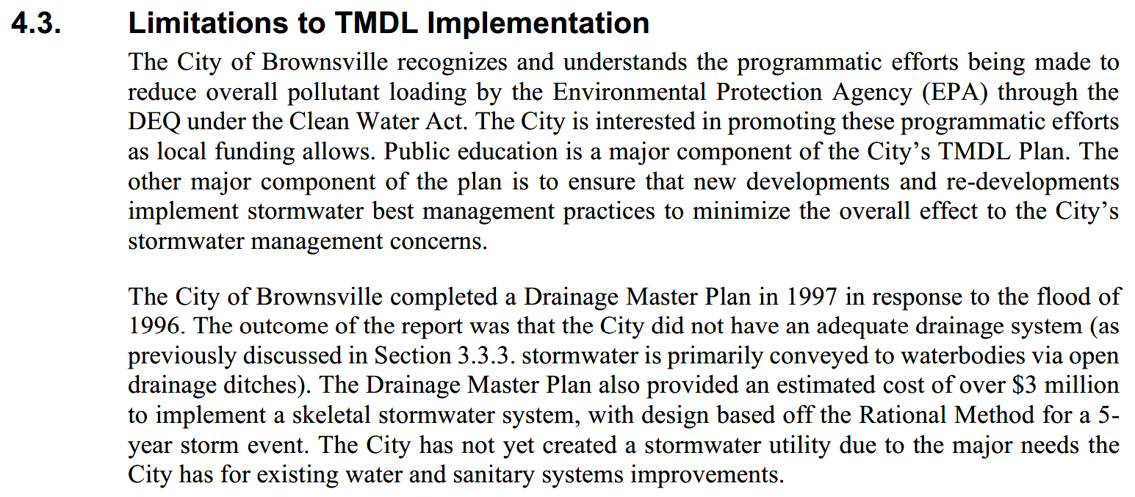

Designated Management Agency (DMA)

Slide 31

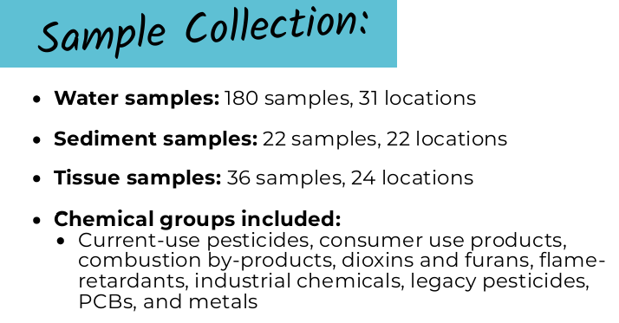
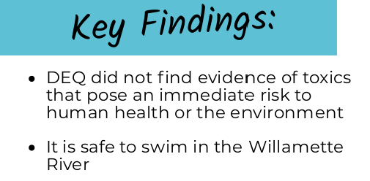
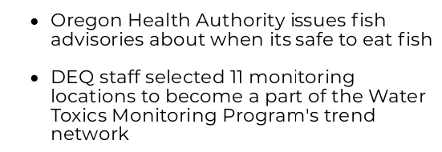
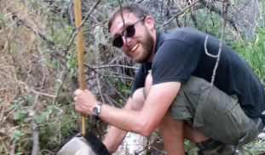

Slide 32
Forever Requirements
Temperature
Bacteria
Mercury
IDDE
All Pollutants
Riparian Vegetation, 2. Public Education, 3. WWTP – NPDES, 4. Tree City, and 5. Park Master Plan*
Pet & Animal Waste, 2. Stormwater BMP’s – Development, 3. I & I - Maintenance & Costs, 4. Erosion & Sediment Control, and 5. WWTP - NPDES
Erosion & Sediment Control, and 2. Stormwater BMP’s – Public Education
Public Reporting & Staff Tracking
Housekeeping: Street Sweeping; Leaf Collection, 2. Council Support, 3. Staff Reporting & Promoting, and 4) Watershed Support*

Slide 33
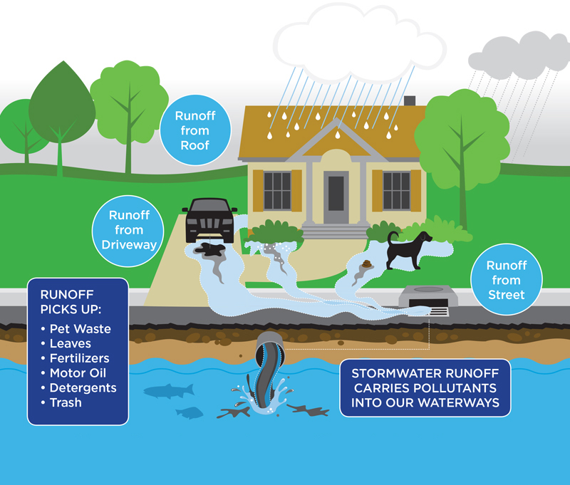

Slide 34
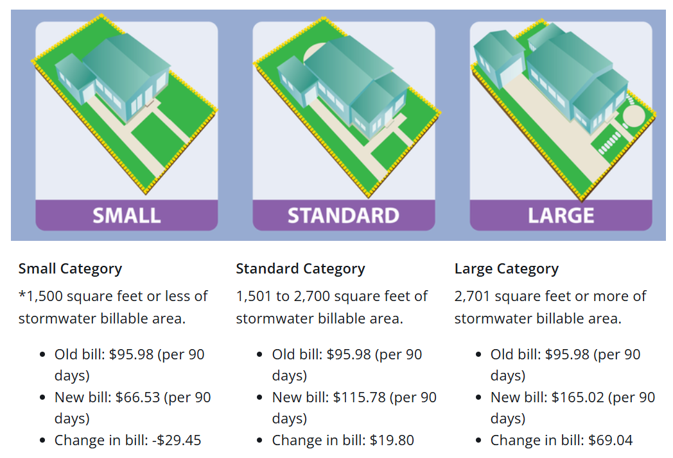

Designated Management Agency (DMA)

Slide 35

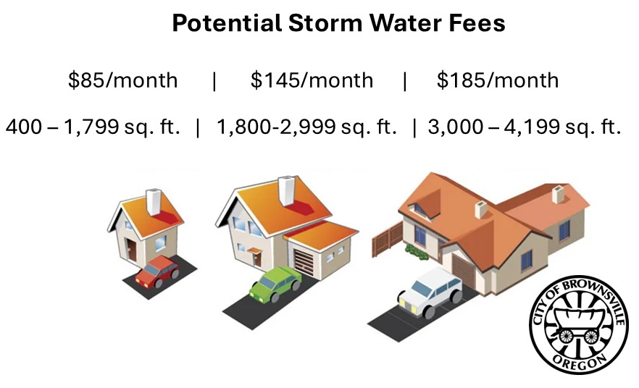

Designated Management Agency (DMA)

Slide 36


Designated Management Agency (DMA)
Monthly Water Fees
Monthly Sewer Fees
The State does not consider these fees high
until they exceed $350/month.

Slide 37






Slide 38






Slide 39








Capital Improvements
Water Treatment
Plant & Distribution
$5M to $7M
Rec Center
$2.1M
Sewer Lagoon+
$2.5M to $3.5M
Downtown Sewers
$512k
GR 12 Waterline
$568k
Kirk Avenue Paving
$2.2M to $3M+
Pavilion
$800k to $1M
Calapooia Riverbank
$2.2M to $2.9M+

Slide 40
Brownsville Canal Company, Inc.
Questions

Slide 41


Brownsville Canal Company, Inc.
How will I be notified for maintenance to the Canal?
The Board will develop policies that attend to these details. More than likely, it will be a phone call for an immediate repair. For larger projects, annual and as-needed meetings will be held to inform residents.

Slide 42


Brownsville Canal Company, Inc.
What about placing a fence or a shed?
You would need to locate your property line as encroachments on Canal property would not be allowed.

Slide 43

Brownsville Canal Company, Inc.
What if I need to install a culvert?
The Company will create standards and policies for installing culverts and other appurtenances as may be needed by the membership.

Slide 44

Brownsville Canal Company, Inc.
What about the Tail Races are they included in this?
There are two diversions that act as 1) a diversion channel to direct water flow before the water gets to Brownsville, and 2) to return the water back to the Calapooia River. Both are a vital part of the Mill Race.

Slide 45

Brownsville Canal Company, Inc.
Past Arguments & Points of Discussion
Fill it in | Filling in the ditch would adversely impact many lots. It would also violate Oregon Drainage Law.

Slide 46

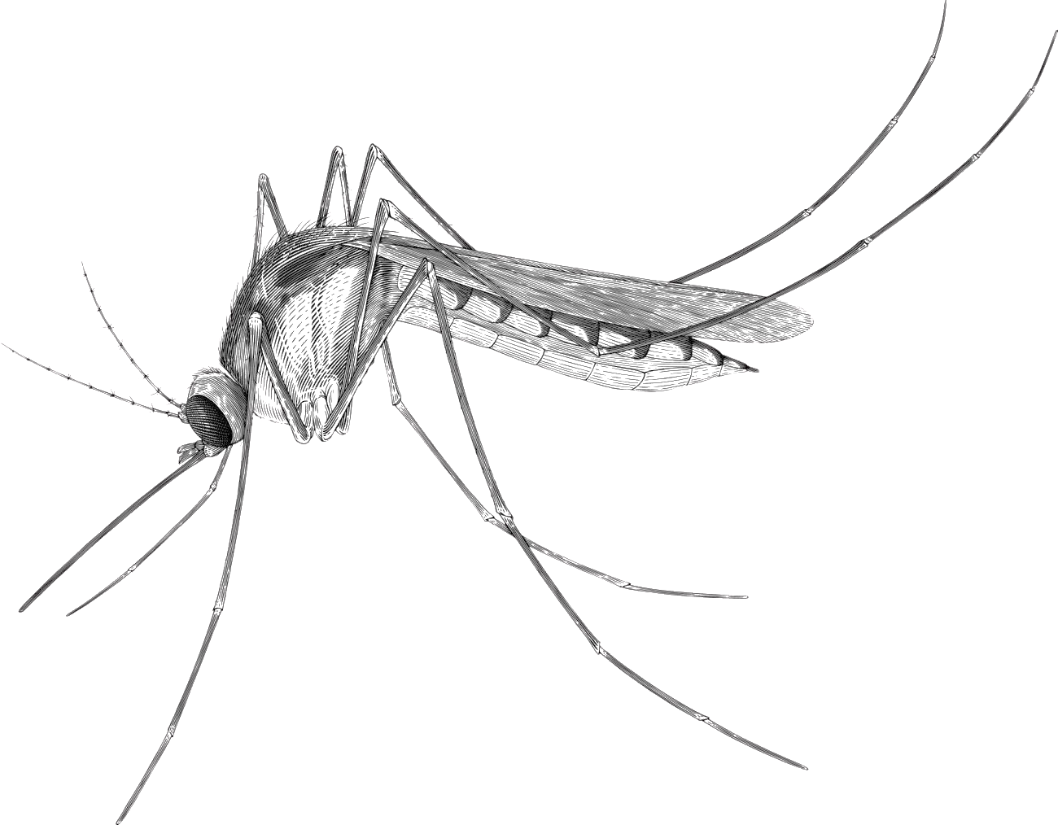
Brownsville Canal Company, Inc.
Past Arguments & Points of Discussion
Abandon it | Allowing the ditch to be abandoned would lead to arguments as to who is responsible for fixing problems and would not allow for the proper operation of the Mill Race.
West Nile
Zika
& More

Slide 47
Brownsville Canal Company, Inc.
Annual Revenue Yield Range
Annual Charge
Total
City 230 Rights
$50 $14,100 $200
$60 $17,050 $250
$70 $20,000 $300
$80 $22,950 $350

Slide 48
Brownsville Canal Company, Inc.
Next Steps

Slide 49

Brownsville Canal Company, Inc.
Hold a Canal Company meeting to vote on whether to move forward with an agreement with the City.
Council would draft an ordinance and assist in finalizing the agreement with the Company.
The agreement & ordinance would determine time frame for charges to be levied and other operational details.

Slide 50
Brownsville Canal Company, Inc.
Thank You

Slide 51
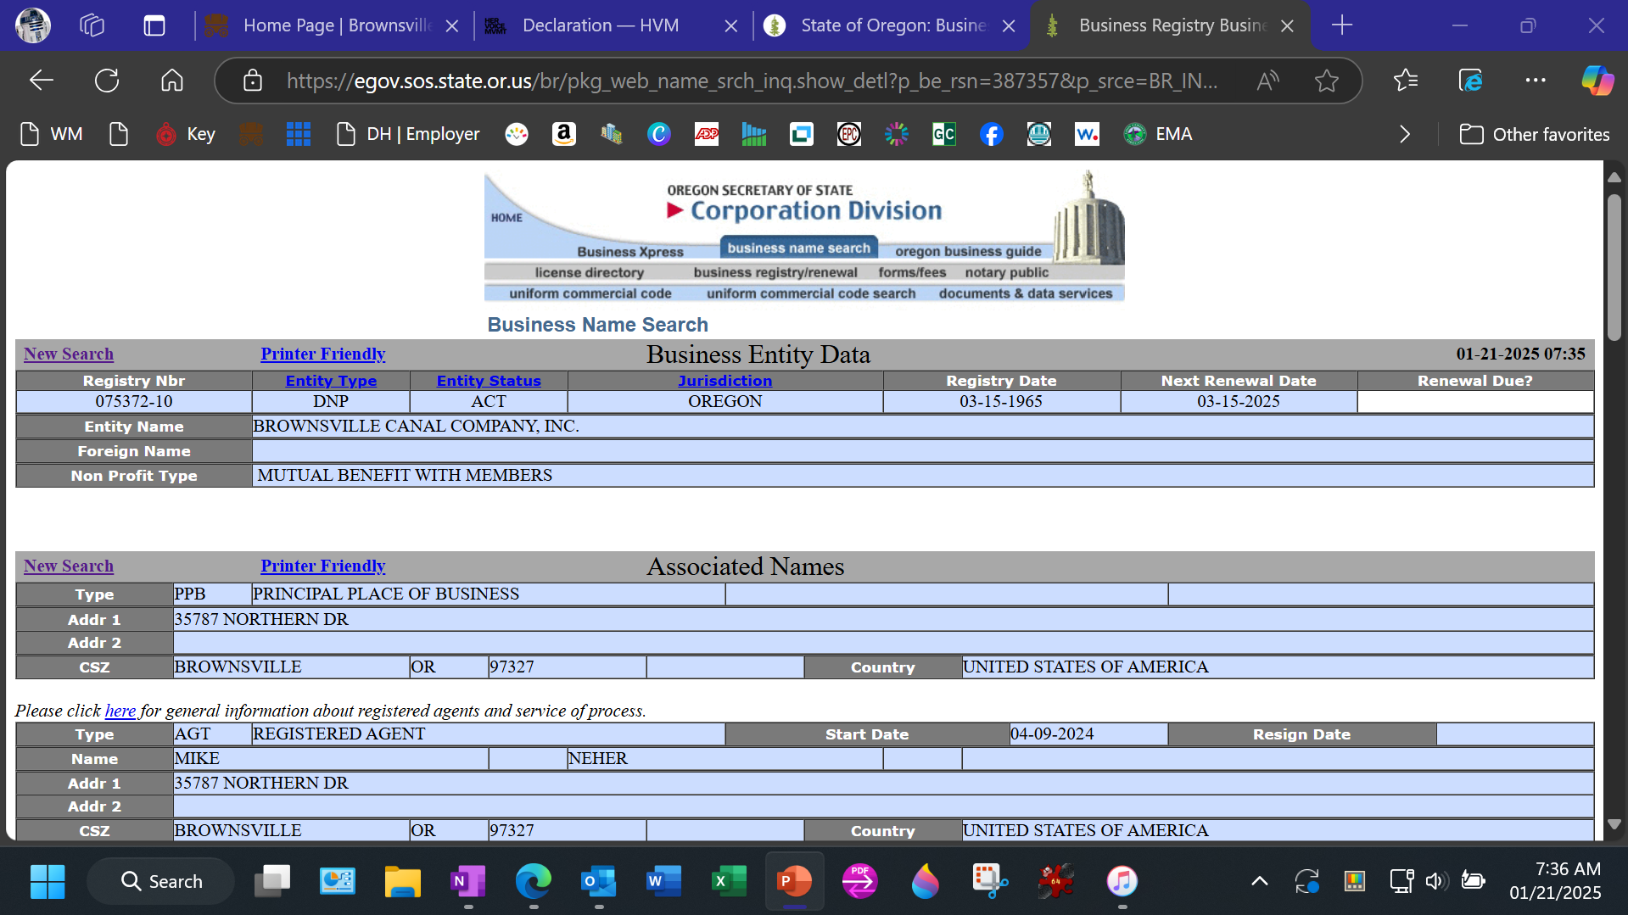

Slide 52
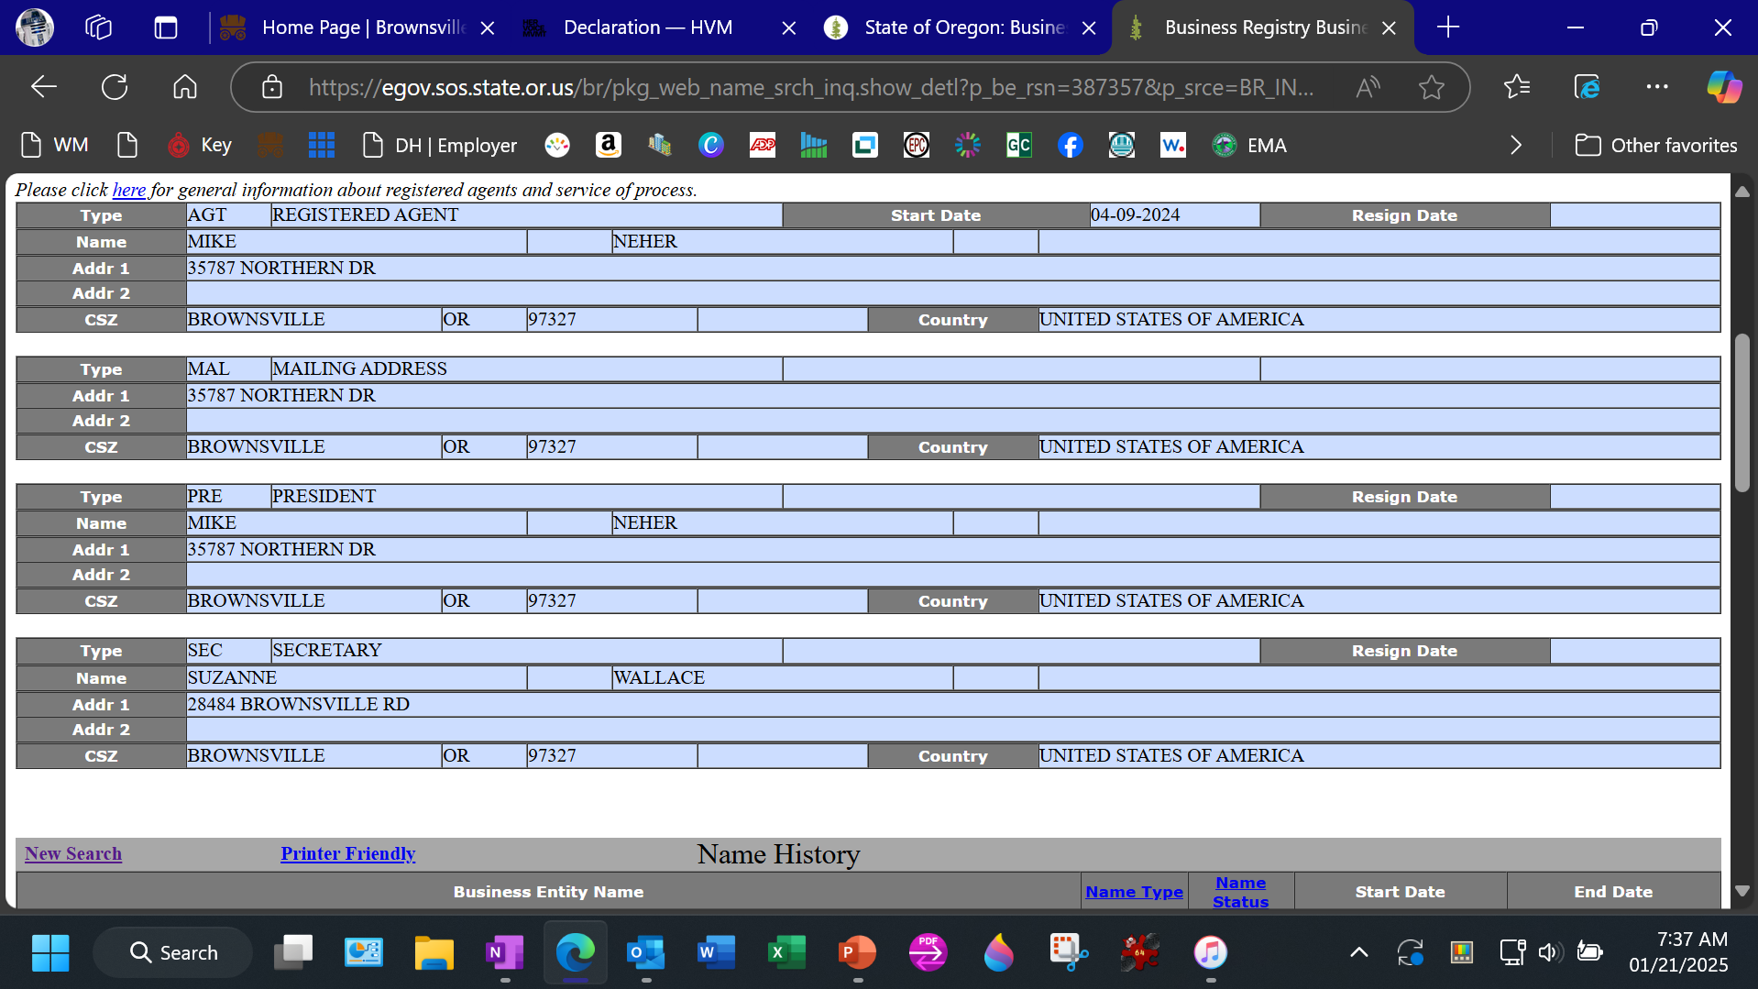

Slide 53
